Slide 1
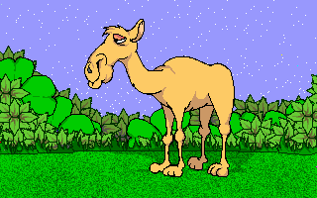
The amazing Camel

Slide 2
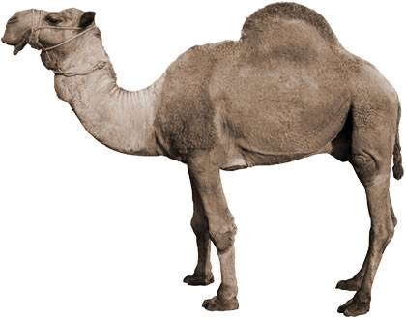
If you ever doubted that God exists, Meet the Very Technical, Highly Engineered
Dromedary Camel.

Slide 3
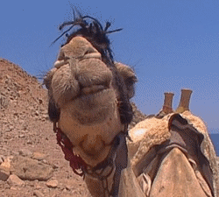
When I'm hungry, I'll eat almost anything- A leather bridle, a piece of rope, my master's tent, Or a pair of shoes.

Slide 4
My mouth is so tough a thorny cactus doesn't bother it. I love to chow down grass and other plants That grow here on the Arabian desert

Slide 5
I'm a dromedary camel, the one-hump kind That lives on hot deserts in the Middle East.
My hump, all eighty pounds of it, Is filled with fat-my body fuel-not water as some people believe. My Mighty Maker gave it to me because He knew I wouldn't always be able to find food

Slide 6
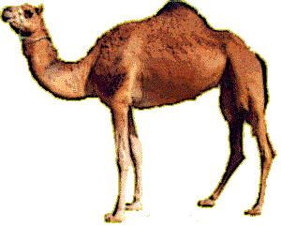
As I travel
across the hot sands. When I don't find
any chow, my body
automatically takes
fat from the hump, feeds my system, and keeps me going strong. This is my emergency food supply.

Slide 7
If I can't find any plants to munch, my body uses up my hump. When the hump
gets smaller,
it starts to tip to one side. But when I get to a nice oasis
and begin to eat again,
my hump soon builds
back to normal.

Slide 8
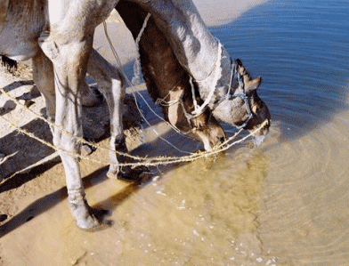
I've been known to drink twenty-seven gallons of water in ten minutes. My Master Designer made me in such a fantastic way that In a matter of
minutes all the water
I've swallowed Travels to the billions
of microscopic cells
that make up my flesh.

Slide 9
Naturally, the water I swallow first goes into my stomach.
There thirsty blood vessels absorb and carry it to every part of my body. Scientists have tested my stomach and found it empty ten minutes after I've drunk twenty gallons.

Slide 10
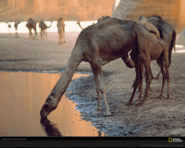
In an eight hour day I can carry a four hundred pound load A hundred miles across a hot, dry desert And not stop once for a drink or something to eat. In fact, I've been known to go eight days without a drink, But then I look a wreck. I lose 227 pounds, my ribs how through my skin, And I look terribly skinny. But I feel great! I look thin because
the billions of cells lose their water. They're no longer fat. They're flat.

Slide 11
Story
I look thin because the billions
of cells lose their water. They're no longer fat.
They're flat.

Slide 12
Normally my blood
Contains 94 percent water,
just like yours. But …
when I can't find any water to drink, The heat of the sun gradually robs a little water out of my blood. Scientists have found that my blood can lose up to 40 percent of its water, and I'm still healthy.

Slide 13
Doctor's say human blood has to stay very close to 94 percent water. If you lose 5 percent of it, you can't see anymore; 10 percent, you can't Hear and you go insane; 12 percent, your blood is as thick as molasses And your heart can't pump the thick stuff. It stops, and you're dead.

Slide 14
But that's not true with me. Why? Scientists say my blood is different. My red cells are elongated.
Yours are round. Maybe that's what makes the difference

Slide 15
This proves I'm designed for the desert, Or the desert is designed for me. Did you ever hear of a design
without a Designer?

Slide 16
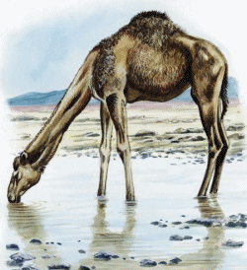
After I find a water hole, I'll drink for about ten minutes And my skinny body starts to change immediately. In that short time my body fills out nicely, I don't look skinny anymore,
And I gain back the 227 pounds I lost.

Slide 17
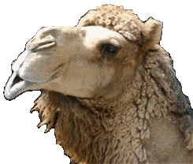
Even though I lose a lot of water on the desert, My body conserves it too. Way in the beginning when my intelligent Engineer made me, He gave me a specially designed nose that saves water. When I exhale, I don't lose much. My nose traps that warm, moist air from my lungs And absorbs it in my nasal membranes.

Slide 18
Tiny blood vessels in those membranes take that back into my blood.
How's that for
a recycling system?
Pretty cool, isn't it. It works because my nose is cool. My cool nose changes that warm moisture in the air from my lungs
back into water.

Slide 19
But how does my nose get cool? I breath in hot dry desert air, And it goes through
my wet nasal passages. This produces a cooling effect,
and my nose stays as much as 18 degrees cooler
than the rest of my body.

Slide 20
I love to travel the beautiful sanddunes. It's really quite easy, because My Creator gave me specially engineered sand shoes for feet. My hooves are wide, and they get
even wider when I step on them. Each foot has two long,
bony toes with tough,
leathery skin between my soles,
are a little like webbed feet.

Slide 21
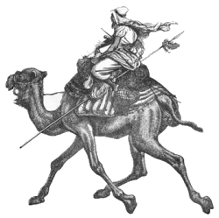
They won't let me sink into the soft, drifting sand. This is good, because often my master wants me to carry him one hundred miles across the desert in just one day.
(I troop about
ten miles per hour.)

Slide 22
Sometimes a big windstorm comes out of nowhere, bringing flying sand with it. My Master Designer put special muscles in my nostrils that close the openings, keeping sand out of my nose but still allowing me
enough air to breathe.

Slide 23
My eyelashes arch down over my eyes like screens, keeping the sand and sun out but still letting me see clearly. If a grain of sand slips through and gets in my eye, the Creator took care of that too. He gave me an inner eyelid that automatically wipes the sand off my eyeball just like a windshield wiper.

Slide 24
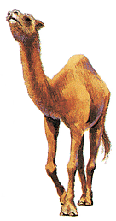
Some people think
I'm conceited
because I always
walk around with my head
held high
and my nose in the air.

Slide 25
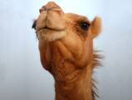
But that's just because of
the way I'm made. My eyebrows are
so thick and bushy I have to hold my head
high to peek out from
underneath them. I'm glad I have them though. They shade my eyes from the bright sun.

Slide 26
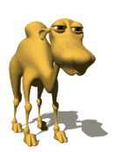
Desert people depend on me for many things. Not only am I their best form of transportation,
but I'm also their grocery store. Mrs. Camel gives very rich milk
that people make into butter and cheese. I shed my thick fur coat once a year, and that can be woven into cloth. A few young camels are used for beef, but I don't like to talk about that.

Slide 27
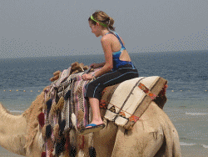
For a long time
we camels have been called the "ships of the desert"
because of the way we sway
from side to side
when we trot. Some of our riders
get seasick.

Slide 28
I sway from side to side because of the way my legs work. Both legs on one side move forward at the same time, elevating that side. My "left, right left,
right" motion
makes my rider feel
Like he is in a rocking
chair going sideways.

Slide 29
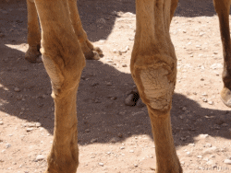
When I was six months old, special knee pads started to grow on my front legs. The intelligent
Creator knew
I had to have them. They help me lower
my 1000 pounds
to the ground.

Slide 30
If I didn't have them, my knees would soon become sore and infected, and I could never lie down. I'd die of exhaustion.

Slide 31
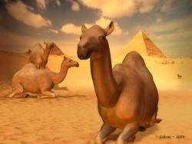
By the way, I don't get thick knee pads because I fall on my knees. I fall on my knees because I already have these tough pads. Someone very great thought of me and knew I needed them. He designed them into my genes.

Slide 32
It's real difficult for me to understand how some people say
I evolved into what I now am. I'm very technical, highly engineered dromedary camel.

Slide 33
With thanks to
Our CREATOR

